Slide 1
INT316 – Modern Web Applications
Unit III

Slide 2
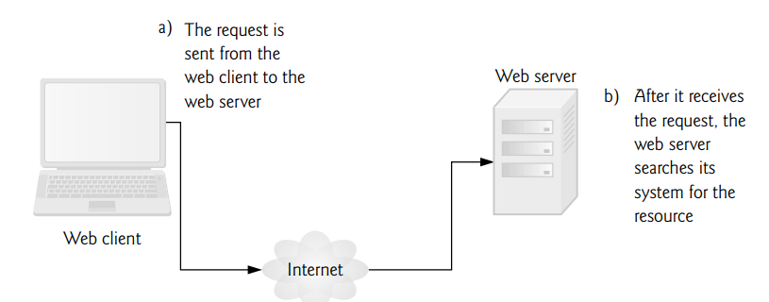
Web Server – Web Client
The fundamentals of web-based interactions between a client web browser and a web server. Making a Request and Receiving a Response
Client interacting with web server. Step 1: The GET request

Slide 3
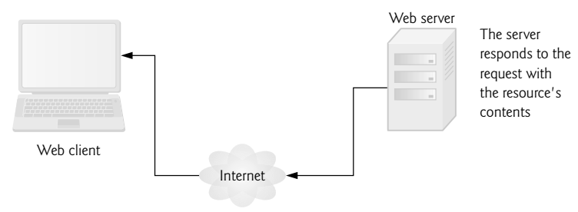
Web Server – Web Client
Making a Request and Receiving a Response
Client interacting with web server. Step 2: The HTTP response

Slide 4
HTTP- Request methods (Get or Post)
The two most common HTTP request types (also known as request methods) are get and post.
A get request typically gets (or retrieves) information from a server,
such as an HTML document,
an image or
search results based on a user-submitted search term.
A post request typically posts (or sends) data to a server.
Common uses of post requests are to send form data or documents to a server.

Slide 5
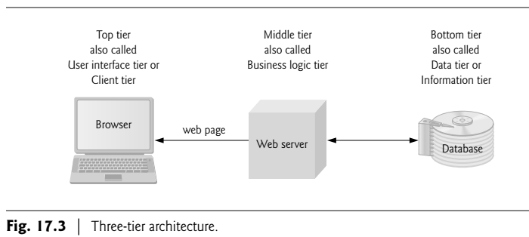
Three-tier architecture

Slide 6
Access Web Server & XAMPP
Users can request documents
from local web servers (i.e., ones residing on users’ machines)
Local web servers can be accessed through your computer’s name or through the name localhost
remote web servers (i.e., ones residing on different machines).
XAMPP integrated installer provided by the Apache Friends website (www.apachefriends.org)
Apache HTTP Server,
MySQL database server and
PHP

Slide 7
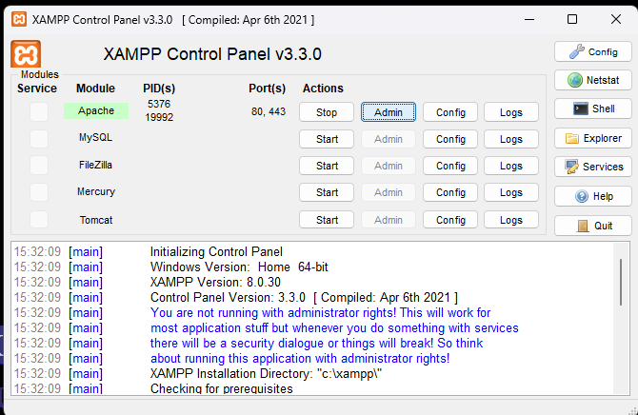
Running the Examples Using Apache HTTP Server
To start Apache Server
From TaskBar Search – type XAMPP
Open XAMPP control panel
Start Apache server
Click to open Browser (localhost)
Save your .php files in
Create a folder in
C:/xampp/htdocs/phppgms
Open browser , type
4) http://localhost/phppgms/first.php

Slide 8
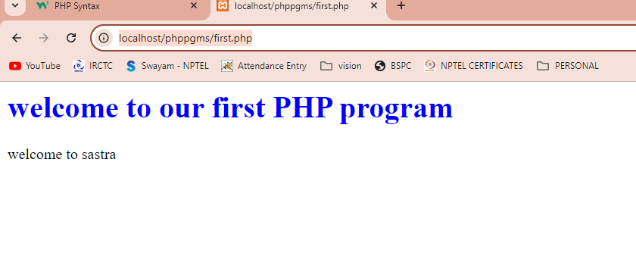
Running the Examples Using Apache HTTP Server
File: first.php
<?php
echo "<h1 style=color:blue;> welcome to our first PHP program </h1>";
echo "welcome to sastra";
?>

Slide 9
Contents
Introduction to PHP
Expressions and Control flow
PHP functions and objects
Array
Form handling
Cookies, Sessions and Authentication
Introduction to MySQL
Accessing MySQL using PHP

Slide 10
PHP Introduction
What is PHP?
PHP is an acronym for "PHP: Hypertext Preprocessor"
PHP is a widely-used, open source scripting language
PHP scripts are executed on the server
What is a PHP File?
PHP files can contain text, HTML, CSS, JavaScript, and PHP code
PHP code is executed on the server, and the result is returned to the browser as plain HTML
PHP files have extension ".php“

Slide 11
PHP Introduction
What Can PHP Do?
PHP can generate dynamic page content
PHP can create, open, read, write, delete, and close files on the server
PHP can collect form data
PHP can send and receive cookies
PHP can add, delete, modify data in your database
PHP can be used to control user-access
PHP can encrypt data

Slide 12
The Structure of PHP
PHP tag
<?php Start tag
?> End tag
The entire sections of PHP should be placed inside these tags
Simple Example
<?php
echo "Hello world";
?>

Slide 13
Using Comments
Using Comments
Single line comment - //
multiple-line comments - /* */
Example:
<?php
// This is a comment
// echo "X equals $x";
$x += 10; // Increment $x by 10
/* This is a section
of multiline comments
which will not be
interpreted */
?>

Slide 14
Program 1
<?php
echo "<h1 style=color:blue;> welcome to our first PHP program </h1>";
echo "welcome to sastra";
?>

Slide 15
Syntax and structure
Syntax and structure
PHP commands and statements ends with a semicolon
$x += 10;
All the variables must be preceded by $ symbol
<?php
$mycounter = 1;
$mystring = "Hello";
$myarray = array("One", "Two", "Three");
?>
PHP leaves you completely free to use (or not use) all the indenting and spacing you like

Slide 16
Variables
Variables
Variable declarations should be preceded with $ symbol. No need to specify any data types.
Strings can be surrounded by single quotes or double quotes.
$username = "Fred Smith"; // string variable
$count = 17; // numeric variable
$count = 17.5; // floating point numeric
Arrays can be created using array() function
$team = array(‘CSK', ‘RCB', ‘SRH', ‘MI', ‘DD‘, ‘KKR’, ‘RR’, ‘PK’);

Slide 17
Variable-naming rules
Variable-naming rules
When creating PHP variables, the below mentioned four rules must be followed:
Variable names, after the dollar sign, must start with a letter of the alphabet or the _ (underscore) character.
Variable names can contain only the characters a-z, A-Z, 0-9, and _ (underscore).
Variable names may not contain spaces. If a variable name must comprise more than one word, a good idea is to separate the words with the _ (underscore) character
(e.g., $user_name).
Variable names are case-sensitive. The variable $High_Score is not the same as the variable $high_score.

Slide 18
Program 2
<!DOCTYPE html>
<html lang="en">
<?php
$variable="Dr.L.Prabaharan"; // variable declaration and initialization
?>
<head>
<meta charset="UTF-8">
<meta name="viewport" content="width=device-width, initial-scale=1.0">
<title>Document</title>
</head>
<body>
<h1>
<?php
print("Your faculty is: $variable"); //output statement
?>
</h1>
</body>
</html>

Slide 19
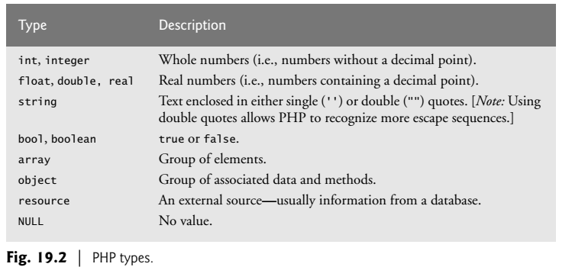
PHP types

Slide 20
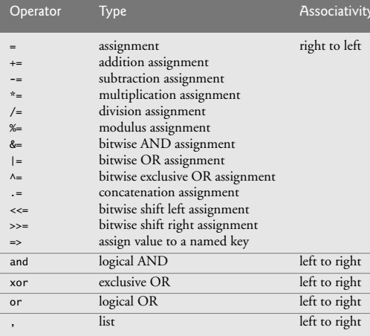
Operator precedence

Slide 21
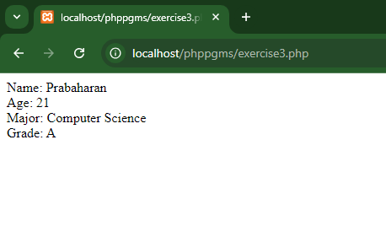
array with key-value pairs
<?php
// Associative array with key-value pairs
$student = array(
"name" => "Prabaharan",
"age" => 21,
"major" => "Computer Science",
"grade" => "A"
);
// Accessing values using keys
echo "Name: " . $student["name"] . "<br>";
echo "Age: " . $student["age"] . "<br>";
echo "Major: " . $student["major"] . "<br>";
echo "Grade: " . $student["grade"];
?>

Slide 22
Operators
Operators
Arithmetic operators
Operator Description Example
+ Addition $j + 1
- Subtraction $j - 6
* Multiplication $j * 11
/ Division $j / 4
% Modulus (the remainder after a division is performed) $j % 9
++ Increment ++$j
-- Decrement --$j
** Exponentiation (or power) $j**2
. String concatenation $s1.$s2

Slide 23
Assignment operators
Assignment operators
Operator Example Equivalent to
= $j = 15 $j = 15
+= $j += 5 $j = $j + 5
-= $j -= 3 $j = $j - 3
*= $j *= 8 $j = $j * 8
/= $j /= 16 $j = $j / 16
.= $j .= $k $j = $j . $k
%= $j %= 4 $j = $j % 4

Slide 24
Comparison operators
Comparison operators
Operator Description Example
== Is equal to $j == 4
!= Is not equal to $j != 21
> Is greater than $j > 3
< Is less than $j < 100
>= Is greater than or equal to $j >= 15
<= Is less than or equal to $j <= 8
<> Is not equal to to $j <> 23
=== Is identical to to $j === "987"
!== Is not identical to to $j !== "1.2e3"

Slide 25
Logical operators
Logical operators
Operator Description Example
&& And $j == 3 && $k == 2
and Low-precedence and $j == 3 and $k == 2
|| Or $j < 5 || $j > 10
or Low-precedence or $j < 5 or $j > 10
! Not ! ($j == $k)
xor Exclusive or $j xor $k

Slide 26
Variable Assignment
Variable Assignment
The syntax to assign a value to a variable is always
variable = value
other_variable = variable.
$x = 10;
$x += 100;
Increment / decrement operators
++$x; $x--;
--$y; $y--;

Slide 27
String concatenation
String concatenation
String concatenation uses the period (.) to append one string of characters to another.
The simplest way to do this is as follows:
$msgs = 5;
echo "You have " . $msgs . " messages.";
The output from this line of code will be the following:
You have 5 messages.
Just as you can add a value to a numeric variable with the += operator, you can append one string to another using .=

Slide 28
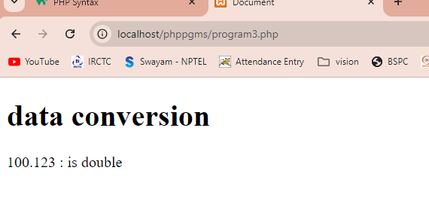
Program 3
<h1> data conversion </h1>
<?php
$floatVar = 100.123;
print(“ $floatVar : is " . gettype($floatVar) );
?>
(dot) string concatenation

Slide 29
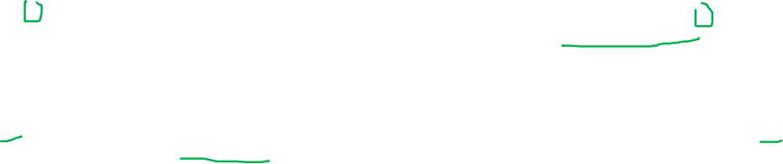
String types
PHP supports two types of strings that are denoted by the type of quotation mark
To assign a literal string, preserving the exact contents, single quotation marks (apostrophes) should be used, like this:
$info = 'Preface variables with a $ like this: $variable';
On the other hand, to include the value of a variable inside a string, double-quotes should be used
echo "This week $count people have viewed your profile";
This syntax offers a simpler option to concatenation without period(.)
This is called variable substitution

Slide 30
Escaping characters
Sometimes a string needs to contain characters with special meanings that might be interpreted incorrectly.
For example, the following line of code will not work, because the second quotation mark encountered in the word spelling’s will tell the PHP parser that the string’s end has been reached.
Consequently, the rest of the line will be rejected as an error:
$text = 'My spelling's atroshus'; // Erroneous syntax
To correct this, add a backslash directly before the offending quotation mark to tell PHP to treat the character literally and not to interpret it:
$text = 'My spelling\'s still atroshus';

Slide 31
Widely used Escape Sequences in PHP
\’ – To escape ‘ within single quoted string.
\” – To escape “ within double quoted string.
\\ – To escape the backslash.
\$ – To escape $.
\n – To add line breaks between string.
\t – To add tab space.
\r – For carriage return.

Slide 32
Multiple-Line Commands
There are times when you need to output quite a lot of text from PHP, and using several echo (or print) statements would be time-consuming and messy.
To overcome this, PHP offers two conveniences.
The first is just to put multiple lines between quotes,
<?php
$author = "Steve Ballmer";
echo "Developers, developers, developers, developers, developers,
developers, developers, developers, developers!
- $author.";
?>

Slide 33
Variables can also be assigned
<?php
$author = "Bill Gates";
$text = "Measuring programming progress by lines of code is like
Measuring aircraft building progress by weight.
- $author.";
echo $text;
?>

Slide 34
PHP also offers a multiline sequence using the <<< operator—commonly referred to as a here-document or heredoc - as a way of specifying a string literal, preserving the line breaks and other whitespace (including indentation) in the text.
<?php
$author = "Brian W. Kernighan";
echo <<<_abc
Debugging is twice as hard as writing the code in the first place. Therefore, if you write the code as cleverly as possible, you are, by definition, not smart enough to debug it.
- $author.
_abc;
?>

Slide 35
Constants
Constants
Constants are similar to variables, holding information to be accessed later, except that they are what they sound like—constant.
Once defined, its value is set for the remainder of the program and cannot be altered.
One example of a use for a constant is to hold the location
define("ROOT_LOCATION", "/usr/local/www/");
Read the contents of the variable, just like a regular variable (but it isn’t preceded by a dollar sign):
$directory = ROOT_LOCATION;

Slide 36
Predefined Constants
Predefined Constants
PHP comes ready-made with dozens of predefined constants that you won’t generally use as a beginner.
magic constants, that will be very useful. The names of the magic constants always have two underscores at the beginning and two at the end

Slide 37
Magic constant Description
__LINE__ The current line number of the file.
__FILE__ The full path and filename of the file. If used inside an include, the name of the included file is returned. Some operating systems allow aliases for directories, called symbolic links; in __FILE__ these are always changed to the actual directories.
__DIR__ The directory of the file. (Added in PHP 5.3.0.) If used inside an include, the directory of the included file is returned. This is equivalent to dirname(__FILE__). This directory name does not have a trailing slash unless it is the root directory.
__FUNCTION__ Returns the function name as it was declared
__CLASS__ Returns the class name as it was declared
__METHOD__ The method name is returned as it was declared
__NAMESPACE__ The name of the current namespace. This constant is defined at compile time

Slide 38
One handy use of these variables is for debugging, when you need to insert a line of code to see whether the program flow reaches it:
echo "This is line " . __LINE__ . " of file " . __FILE__;
This prints the current program line in the current file (including the path) to the web browser.

Slide 39
echo and print Commands
The Difference Between the echo and print Commands
echo and print both commands are quite similar
print is a function-like construct that takes a single parameter and has a return value (which is always 1), whereas echo is purely a PHP language construct.
Since both commands are constructs, neither requires parentheses.
echo command usually will be faster than print, because it doesn’t set a return value.
Because echo isn’t implemented like a function, echo cannot be used as part of a more complex expression, whereas print can.

Slide 40
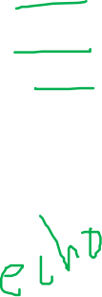
<?php print "<h2>PHP is Fun!</h2>"; print "Hello world!<br>"; print "I'm about to learn PHP!"; ?>

Slide 41
Functions
Functions
Function is a separate sections of code that perform a particular task.
Creating functions not only shortens program and makes it more readable, but also adds extra functionality, because functions can be passed parameters to make them perform differently.
Functions can also return values to the calling code.

Slide 42
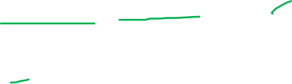
Functions
A user-defined function declaration starts with the word function:
General format:
function functionName() {
code to be executed;
}
Example:
<?php function writeMsg() { echo "Hello world!"; } writeMsg(); // call the function ?>

Slide 43
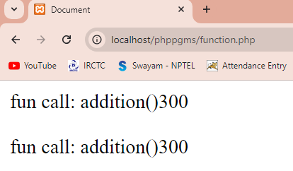
Function Program
<!DOCTYPE html>
<html lang="en">
<head> <title>Document</title> </head>
<body>
<?php
function add($a, $b)
{
return $a+$b;
}
$num1=100;
$num2=200;
echo"fun call: addition()".add($num1,$num2);
echo"<br><br>";
print("fun call: addition()".add($num1,$num2));
?>
</body>
</html>

Slide 44

Variable Scope
Variable Scope
In PHP, variables can be declared anywhere in the script.
The scope of a variable is the part of the script where the variable can be referenced/used.
PHP has three different variable scopes:
local
global
static

Slide 45
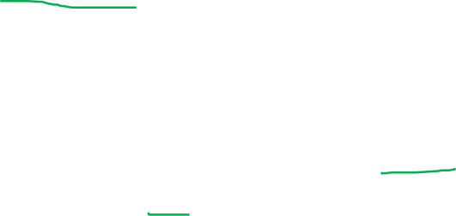
Variable Scope
Local variables
Local variables are variables that are created within, and can be accessed only by, a function.
They are generally temporary variables that are used to store partially processed results prior to the function’s return.
<?php function addNumbers(int $a, int $b) {
$c = $a + $b; // Here c is local variable return $c; } echo addNumbers(5, 20); ?>

Slide 46
Variables created outside of any functions can be accessed only by nonfunction code.
<?php
$result = "The output is ";
echo addnumbers(20,40);
function addnumbers($a, $b) {
return $result.($a+$b);
}
?>
The above code will give “undefined variable error”. Because, $result created outside the function, and it can be accessed only by the code which is outside of any function.

Slide 47
Global variables
Global variables
A variable declared outside a function has a GLOBAL SCOPE and can only be accessed outside a function
The global keyword is used to access a global variable from within a function.

Slide 48
Global variables
<?php
$x = 5; // global scope
$y = 10; // global scope
function myTest() {
global $x, $y; // global key word usage
$y = $x + $y;
}
myTest();
echo $y; // outputs 15
?>

Slide 49
Static variables
Static variables
Normally, when a function is completed/executed, all of its variables are deleted. However, sometimes we want a local variable NOT to be deleted. We need it for a further job.
To do this, use the static keyword when you first declare the variable.
Static variables cannot be assigned with the result of an expression in their definitions. They can be initialized only with predetermined values

Slide 50
Static variables
Example:
<?php function myTest() { static $x = 0; echo $x; $x++; } myTest(); // prints 0 myTest(); // prints 1 myTest(); // prints 2 ?>
Example:
<?php function myTest() { static $int = 0; // Allowed
static $int = 1+2; // Disallowed
static $int = sqrt(144); // Disallowed
} myTest();
?>

Slide 51
Superglobal variables
Superglobal variables
Several predefined global variables are available. These are known as superglobal variables
These are provided by the PHP environment but are global within the program, accessible absolutely everywhere.
These superglobals contain lots of useful information about the currently running program and its environment

Slide 52
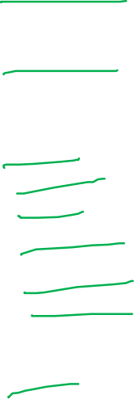
Superglobal variables
Superglobal name Contents
$GLOBALS All variables that are currently defined in the global scope of the script. The variable names are the keys of the array.
$_SERVER Information such as headers, paths, and locations of scripts. The entries in this array are created by the web server, and there is no guarantee that every web server will provide any or all of these.
$_GET Variables passed to the current script via the HTTP GET method.
$_POST Variables passed to the current script via the HTTP POST method.
$_FILES Items uploaded to the current script via the HTTP POST method.
$_COOKIE Variables passed to the current script via HTTP cookies.
$_SESSION Session variables available to the current script.
$_REQUEST Contents of information passed from the browser; by default, $_GET, $_POST, and $_COOKIE.
$_ENV Variables passed to the current script via the environment method.

Slide 53
Program 5
<!DOCTYPE html>
<html lang="en">
<head>
<meta charset="UTF-8">
<meta name="viewport" content="width=device-width, initial-scale=1.0">
<title>Odd or Even Checker</title>
</head>
<body>
<form method="post" action="">
<label for="number">Enter a number:</label>
<input type="text" id="number" name="number" required>
<input type="submit" value="Check">
</form>
<?php
if ($_SERVER["REQUEST_METHOD"] == "POST") {
// Get the value from the HTML text box
$number = $_POST['number'];
// Check if the input is a number
if (is_numeric($number)) {
// Check if the number is even or odd
if ($number % 2 == 0) {
echo "<p>The number $number is Even.</p>";
} else {
echo "<p>The number $number is Odd.</p>";
}
} else {
echo "<p>Please enter a valid number.</p>";
}
}
?>
</body>
</html>

Slide 54
Problem Scenario
Scenario:
You are supposed to create a small PHP application that checks whether a person is listed as your friend. The application displays a message indicating if the person's name is found in the predefined list of friends. The user is prompted to enter their name, and if it matches any of the names in the list, a success message is displayed showing their position in the list.

Slide 55
Program 6
<!DOCTYPE html>
<html lang="en">
<head>
<meta charset="UTF-8">
<meta name="viewport" content="width=device-width, initial-scale=1.0">
<title>Document</title>
</head>
<body>
<h2>Checking...! Are you my Friend....?</h2>
<form method="post" action="">
<label for="txtName">Enter Your Name [check you are my friend or not..?]: </label>
<input type="text" id="txtName" name="txtName" required>
<input type="submit" value="Submit">
</form>

Slide 56
Program 6
<?php
$flg=FALSE;
$position=0;
$friend="" ;
$arrayFriends = array('Krupahari','Gowri','Keerthana','karthika','kruthika','Asma', 'kamala');
function showFriends()
{ global $arrayFriends;
for ($i=0; $i< 5;$i++)
print("$arrayFriends[$i]<br>");
}
if ($_SERVER["REQUEST_METHOD"] == "POST") {
$friend= $_POST['txtName'];

Slide 57
Program 6
for ($i=0;$i<count($arrayFriends);$i++)
{
if( strtolower($friend)==strtolower($arrayFriends[$i]))
{ $flg=TRUE;
$position=$i+1;
break; }
}
if ($flg==TRUE)
{
echo "<p style=color:blue> Congratulations..! you are my Friend, found @ $position </p>";
showFriends();
}
else
{
echo "<p style=color:blue> Not found </p>";
showFriends();
}
}
?>
</body> </html>

Slide 58
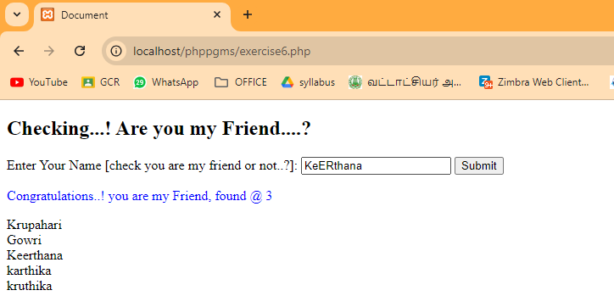
output

Slide 59
Client & Server Scripting on the same Page
Validate the form inputs:
Client side scripting: Check whether the Textbox is empty or Not
Server side scripting: Check the textbox value is expected text

Slide 60
Program Sample
<!DOCTYPE html>
<html lang="en">
<head>
<meta charset="UTF-8">
<meta name="viewport" content="width=device-width, initial-scale=1.0">
<title>Document</title>
</head>
<body>
<script>
function validateForm() {
var inputText = document.getElementById("inputText").value;
if (inputText == "") {
alert("Text box cannot be empty");
}
}
</script>
<?php
$validationMessage = "";
if ($_SERVER["REQUEST_METHOD"] == "POST") {
$inputText = $_POST["inputText"];
if ($inputText == "SASTRA") {
$validationMessage = "Text is valid!";
} else {
$validationMessage = "Text must be 'SASTRA'";
}
echo "<p style=color:blue> $validationMessage </p>";
}
?>
<form method="POST" action="" onsubmit="validateForm()">
<label for="inputText">Enter Text:</label>
<input type="text" id="inputText" name="inputText">
<input type="submit" value="Submit">
</form>
</body> </html>
exercise6,.php

Slide 61
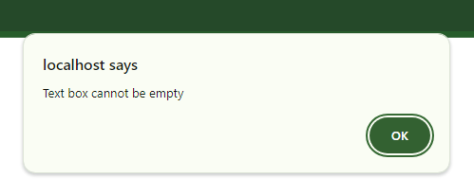
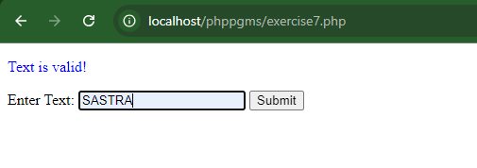
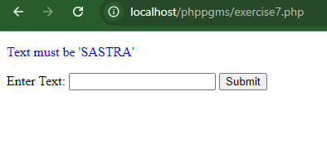
Alert message is shown, when the button is clicked without having any text

Slide 62
Conditionals
Conditionals alter program flow
Conditionals are central to creating dynamic web because they make it easy to render different output each time a page is viewed.
Three basic conditionals are,
the if statement
the switch statement
the ? operator

Slide 63
if Statement
The if statement executes some code if one condition is true.
if (condition) {
code to be executed if condition is true;
}
<?php
$t = date("H");
if ($t < "20") {
echo "Have a good day!";
}
?>

Slide 64
The if...else statement
if (condition) {
code to be executed if condition is true;
} else {
code to be executed if condition is false;
}
Example
<?php
$t = date("H");
if ($t < "20") {
echo "Have a good day!";
} else {
echo "Have a good night!";
}
?>

Slide 65
The if...elseif...else Statement
if (condition) {
code to be executed if this condition is true;
} elseif (condition) {
code to be executed if first condition is false and this condition is true;
} else {
code to be executed if all conditions are false;
}
<?php
$t = date("H");
if ($t < "10") {
echo "Have a good morning!";
} elseif ($t < "20") {
echo "Have a good day!";
} else {
echo "Have a good night!";
}
?>

Slide 66
switch Statement
switch (n) {
case label1:
code to be executed if n=label1;
break;
case label2:
code to be executed if n=label2;
break;
case label3:
code to be executed if n=label3;
break;
...
default:
code to be executed if n is different from all labels;
}
<?php
$favcolor = "red";
switch ($favcolor) {
case "red":
echo "Your favorite color is red!";
break;
case "blue":
echo "Your favorite color is blue!";
break;
case "green":
echo "Your favorite color is green!";
break;
default:
echo "Your favorite color is neither red, blue, nor green!";
}
?>

Slide 67
The switch statement is useful where one variable, or the result of an expression, can have multiple values, each of which should trigger a different activity.
To break out of the switch statement because a condition has been fulfilled, use the break command. This command tells PHP to exit the switch and jump to the following statement.
A typical requirement in switch statements is to fall back on a default action if none of the case conditions are met.

Slide 68
The ternary operator(?: )
One way of avoiding the verbosity of if and else statements is to use the more compact ternary operator, ?, which is unusual in that it takes three operands rather than the typical two.
The ? operator is passed an expression that it must evaluate, along with two statements to execute: one for when the expression evaluates to TRUE, the other for when it is FALSE.
<?php
$a = 10;
$b = $a > 15 ? 20 : 5;
print ("Value of b is " . $b);
?>

Slide 69
Loops (Iterations)
Loops are used to execute the same block of code again and again, as long as a certain condition is true.
In PHP, we have the following loop types:
while - loops through a block of code as long as the specified condition is true
do...while - loops through a block of code once, and then repeats the loop as long as the specified condition is true
for - loops through a block of code a specified number of times
foreach - loops through a block of code for each element in an array

Slide 70
The while loop
The while loop executes a block of code as long as the specified condition is true.
while (condition is true) {
code to be executed;
}
The example below displays the numbers from 1 to 5:
<?php
$x = 1;
while($x <= 5) {
echo "The number is: $x <br>";
$x++;
}
?>

Slide 71
The do while Loop
The do...while loop - Loops through a block of code once, and then repeats the loop as long as the specified condition is true.
The do...while loop will always execute the block of code once, it will then check the condition, and repeat the loop while the specified condition is true.
do {
code to be executed;
} while (condition is true);

Slide 72
The given example below first sets a variable $x to 1 ($x = 1). Then, the do while loop will write some output, and then increment the variable $x with 1. Then the condition is checked (is $x less than, or equal to 5?), and the loop will continue to run as long as $x is less than, or equal to 5:
<?php
$x = 1;
do {
echo "The number is: $x <br>";
$x++;
} while ($x <= 5);
?>

Slide 73
The for Loop
Loops through a block of code a specified number of times.
The for loop is used when you know in advance how many times the script should run.
for (init counter; test counter; increment counter) {
code to be executed for each iteration;
}

Slide 74
Parameters:
init counter: Initialize the loop counter value
test counter: Evaluated for each loop iteration. If it evaluates to TRUE, the loop continues. If it evaluates to FALSE, the loop ends.
increment counter: Increases the loop counter value
The example below displays the numbers from 0 to 10:
<?php
for ($x = 0; $x <= 10; $x++) {
echo "The number is: $x <br>";
}
?>

Slide 75
The foreach Loop
The foreach loop - Loops through a block of code for each element in an array.
The foreach loop works only on arrays, and is used to loop through each key/value pair in an array.
foreach ($array as $value) {
code to be executed;
}

Slide 76
For every loop iteration, the value of the current array element is assigned to $value and the array pointer is moved by one, until it reaches the last array element.
The following example will output the values of the given array ($colors):
<?php
$colors = array("red", "green", "blue", "yellow");
foreach ($colors as $value) {
echo "$value <br>";
}
?>

Slide 77
Break and Continue
Break
Break statement used to "jump out" of a switch statement.
Break statement can also be used to jump out of a loop.
This example jumps out of the loop when x is equal to 4:
<?php
for ($x = 0; $x < 10; $x++) {
if ($x == 4) {
break;
}
echo "The number is: $x <br>";
}
?>

Slide 78
Continue
The continue statement breaks one iteration (in the loop), if a specified condition occurs, and continues with the next iteration in the loop.
This example skips the value of 4:
<?php
for ($x = 0; $x < 10; $x++) {
if ($x == 4) {
continue;
}
echo "The number is: $x <br>";
}
?>

Slide 79
Break and Continue in While Loop
Break Example
<?php
$x = 0;
while($x < 10) {
if ($x == 4) {
break;
}
echo "The number is: $x <br>";
$x++;
}
?>
Continue Example
<?php
$x = 0;
while($x < 10) {
if ($x == 4) {
$x++;
continue;
}
echo "The number is: $x <br>";
$x++;
}
?>

Slide 80
Implicit and Explicit Casting
PHP is a loosely typed language that allows us to declare a variable and its type simply by using it.
PHP automatically converts values from one type to another whenever required. This is called implicit casting.
<?php
$a = 56;
$b = 12;
$c = $a / $b;
echo $c;
?>

Slide 81

However, at times PHP’s implicit casting may not be required. In Example note that the inputs to the division are integers. By default, PHP converts the output to floating point so it can give the most precise value
What if we had wanted $c to be an integer instead?
We can force the result of $a / $b to be cast to an integer value using the integer cast type (int), this is called as explicit type casting.
$c = (int) ($a / $b);

Slide 82
PHP’s cast types
Cast type Description
(int) (integer) Cast to an integer by dropping the decimal portion.
(bool) (boolean) Cast to a Boolean.
(float) (double) (real) Cast to a floating-point number.
(string) Cast to a string.
(array) Cast to an array.
(object) Cast to an object.

Slide 83
Form Handling
Building Forms
Handling forms is a multipart process.
First is the creation of a form into which a user can enter the required details.
This data is then sent to the web server, where it is interpreted, often with some error checking.
If the PHP code identifies one or more fields that require reentering, the form may be redisplayed with an error message.
When the code is satisfied with the accuracy of the input, it takes some action that usually involves the database, such as entering details about a purchase.

Slide 84
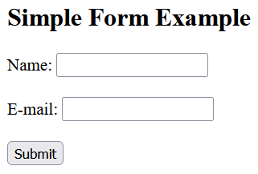
<html> <body> <form action="welcome.php" method="post"> Name: <input type="text" name="name"><br><br> E-mail: <input type="text" name="email"><br><br> <input type="submit“ value=“Submit”> </form> </body> </html>
The example displays a simple HTML form with two input fields and a submit button

Slide 85
Retrieving Submitted Data
The html form is only one part of the multipart form-handling process.
If we enter a name, mail id and click the Submit button, error page will be displayed (“welcome.php” file not found error)
So now it’s time to add some PHP code to process the data submitted by the form

Slide 86
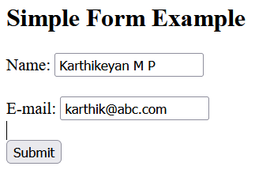

To display the submitted data we can use echo statement. The "welcome.php" looks like this:
<html> <body style=“font-size:20px”> Welcome <?php echo $_POST["name"]; ?><br> Your email address is: <?php echo $_POST["email"]; ?> </body> </html>

Slide 87
Browser sends user input through either a GET request or a POST request.
The web server bundles up all of the user input (even if the form was filled out with a hundred fields) and puts in into an array named $_POST.
$_POST is an associative array.
Depending on whether a form has been set to use the POST or the GET method, either the $_POST or the $_GET associative array will be populated with the form data.
Each field has an element in the array named after that field. So, if a form contains a field named “email”, the $_POST array contains an element keyed by the word “email”.
The PHP program can read that field by referring to either $_POST[‘email'] or $_POST[“email"]

Slide 88
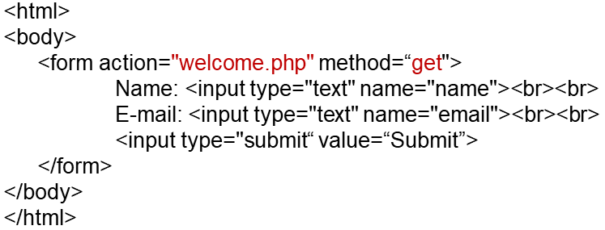
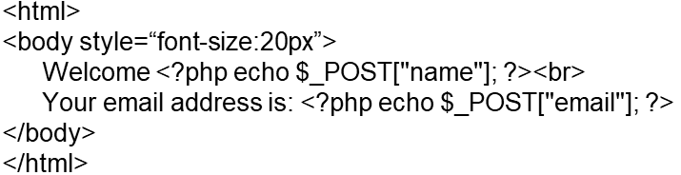
The same program can be implemented using GET method

Slide 89
GET vs. POST
Both GET and POST create an array (e.g. array( key1 => value1, key2 => value2, key3 => value3, ...)). This array holds key/value pairs, where keys are the names of the form controls and values are the input data from the user.
Both GET and POST are treated as $_GET and $_POST. These are superglobals, which means that they are always accessible, regardless of scope - and you can access them from any function, class or file without having to do anything special.
$_GET is an array of variables passed to the current script via the URL parameters.
$_POST is an array of variables passed to the current script via the HTTP POST method.

Slide 90
When to use GET?
Information sent from a form with the GET method is visible to everyone (all variable names and values are displayed in the URL).
GET also has limits on the amount of information to send. The limitation is about 2000 characters.
However, because the variables are displayed in the URL, it is possible to bookmark the page. This can be useful in some cases.
GET may be used for sending non-sensitive data.
Note: GET should NEVER be used for sending passwords or other sensitive information!

Slide 91
When to use POST?
Information sent from a form with the POST method is invisible to others (all names/values are embedded within the body of the HTTP request) and has no limits on the amount of information to send.
Moreover POST supports advanced functionality such as support for multi-part binary input while uploading files to server.
However, because the variables are not displayed in the URL, it is not possible to bookmark the page.

Slide 92
Default Values
Sometimes it’s convenient to offer your site visitors a default value in a web form.
For example, suppose you put up a loan repayment calculator widget on a real estate website.
It could make sense to enter default values of, say, 25 years and 6 percent interest,so that the user can simply type either the principal sum to borrow or the amount that they can afford to pay each month.

Slide 93
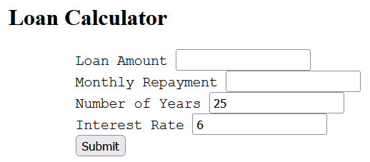
<body style="font-size:20px">
<h2>Loan Calculator</h2>
<form method="post" action="calc.php">
Loan Amount <input type="text" name="principle"><br>
Monthly Repayment <input type="text" name="monthly"><br>
Number of Years <input type="text" name="years" value="25"><br>
Interest Rate <input type="text" name="rate" value="6"><br>
<input type="submit" value="Submit">
</form>
</body>

Slide 94
Validate : userName & MobileNo
<!DOCTYPE html>
<html lang="en"> <head>
<body> <h1 style="color:Orange;"> Login Page </h1>
<script>
function fun1()
{
var input1 = document.getElementById("txtbox1").value;
var input2 = document.getElementById("txtbox2").value;
const mobilePattern = /^[0-9]{10}$/;
if (input1 == "" || input2== ""){
alert("Text box cannot be empty");
return false;}
else if (input1.length < 3 || input2.length > 15) {
alert("Name must be between 3 and 15 characters long");
return false;}
else if(!mobilePattern.test(input2)){
alert("Mobile number must be exactly 10 digits");
return false;}
} </script>

Slide 95
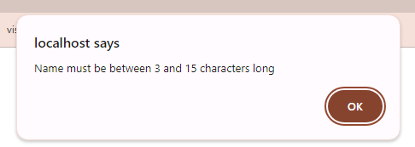
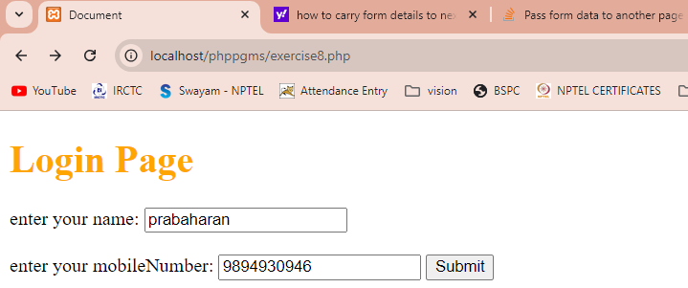
Validate : userName & MobileNo
<form method="POST" action="display.php" onsubmit="return fun1()" >
<label for="txtbox1">enter your name:</label>
<input type="text" id="txtbox1" name="txtbox1" require><br>
<br><label for="txtbox2">enter your mobileNumber:</label>
<input type="text" id="txtbox2" name="txtbox2" require>
<input type="submit" value="Submit" id="btn" name="btn">
</form>
</body>
</html>

Slide 96
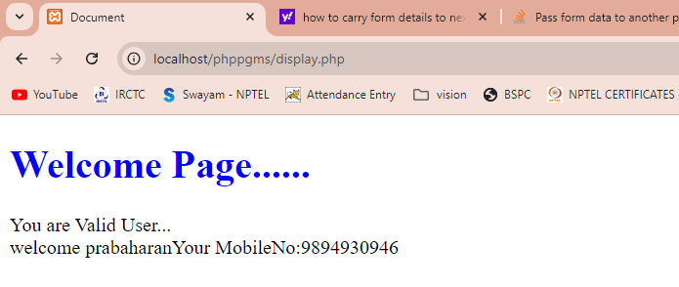
Validated data shown on Next Page
If we want to take the form content
Across the pages, we need
cookie

Slide 97
Cookie
What is a Cookie?
A cookie is often used to identify a user. A cookie is a small file that the server embeds on the user's computer. Each time the same computer requests a page with a browser, it will send the cookie too. With PHP, you can both create and retrieve cookie values.
Create Cookies With PHP
A cookie is created with the setcookie() function.
Syntax:
setcookie(name, value, expire, path, domain, secure, httponly);

Slide 98
Sample Code -cookie
<?php
// Set a cookie named "cookieVar" with value "CSBS-2024" that expires in 1 hour (3600 seconds)
setcookie("cookieVar", "CSBS-2024", time() + 3600, "/"); // The "/" means the cookie is available for the entire domain
// Check if cookie is set global variable
if (isset($_COOKIE["cookieVar"])) {
echo "'cookieVar:' is set!<br>";
echo "Value: " . $_COOKIE["cookieVar"];
} else {
echo "CookieVar is not set!";
}
?>

Slide 99
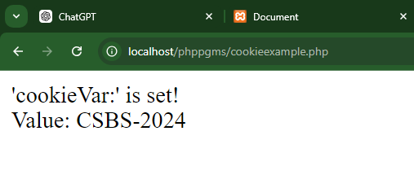
Output

Slide 100
References
https://www.w3schools.com/PHP/default.asp
Robin Nixon, Learning PHP, MySQL, JavaScript, CSS & HTML5, Oreilly, Third Edition, 2014.

